Slide 1
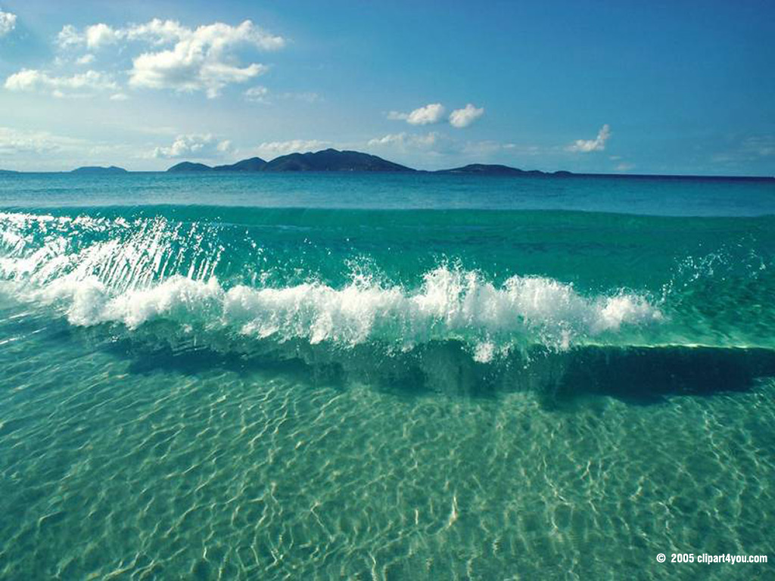
Ocean Energy

Slide 2
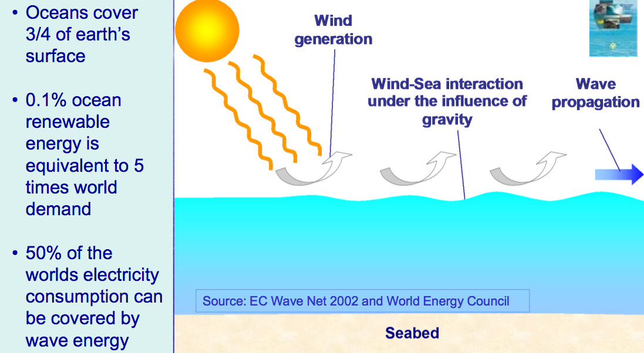
Source of Ocean Wave Energy

Slide 3
Energy from oceans
Ocean energy conversion technologies
Ocean biomass energy
Ocean geothermal energy
Ocean salinity gradient energy
Ocean chemical energy

Slide 4
Ocean tidal energy
Hydro energy in ocean tides.
Ocean tides occurs due to the gravitational attractive forces from sun and moon.
Level of ocean water rises periodically during high tides and drops during low tides.
Difference in head of water-rotates hydro turbine generator-installed in barrages(dams).
Time span between high and low tides 6 hours 25 minutes.
High tide-water head 2 to 5 m

Slide 5
Ocean energy routes
Ocean thermal energy
OTEC plant
*Pumping system
*Heat exchanger
*Vapour turbine generator
*condenser
A.C electrical energy to consumers
Ocean wave energy
Ocean wave energy converter
*Wave machine
*Generator
A.C electrical energy to consumers
Ocean tidal energy
Ocean tidal power plant
*Barrage
*Turbine Generator
A.C electrical energy to consumers
Ocean biomass energy
Ocean biomass farm
*Algae
*ocean kelp
*Aquatic plants
Biomass harvesting plant

Slide 6
Ocean wave energy
Refers to the waves of water from ocean to shore.
Ocean waves occurs due to rotation of earth and wind over ocean surface.
Ocean waves have hydro wave energy with a interval 4 to 12 seconds
Crest few centimetres to about 10m.
Ocean wave machines are installed on floating power plants or on-shore power plants
Rotor-wave machine –rotated by wave energy.
Wave machine drives-generator rotor or pumps water-reservoir at higher level

Slide 7
Ocean thermal energy conversion (OTEC)
Ocean Thermal Energy Conversion (OTEC) is a process that can produce electricity by using the temperature difference between deep cold ocean water and warm tropical surface waters.

Slide 8
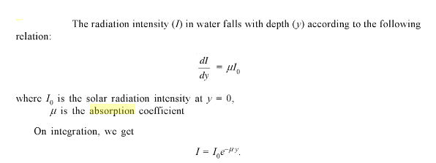
Lambert’s law of absorption
Solar energy absorption by the water takes place acoording to Lambert’s law of absorption.
“Each layer of equal thickness absorbs the same fraction of light that passes through it”

Slide 9
Ocean thermal energy converter (OTEC)
OTEC process types:
Flashed steam, steam turbine cycle OTEC plant using steam water as working fluid-open cycle OTEC.
Binary cycle OTEC plant based on working fluid of low boiling point (e.g. NH3,Propane)-closed cycle OTEC

Slide 10
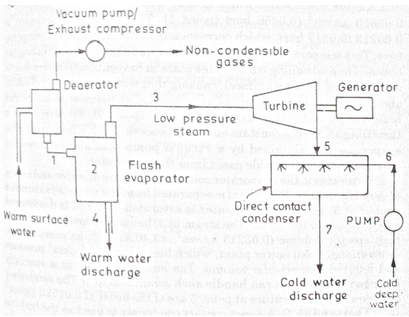
Open cycle (Claude)OTEC

Slide 11
Open-cycle systems use the tropical oceans' warm surface water to make electricity.
When warm seawater is placed in a low-pressure container, it boils.
The expanding steam drives a low-pressure turbine attached to an electrical generator.
The steam, which has left its salt behind in the low-pressure container, is almost pure, fresh water.
It is condensed back into a liquid by exposure to cold temperatures from deep-ocean water.

Slide 12
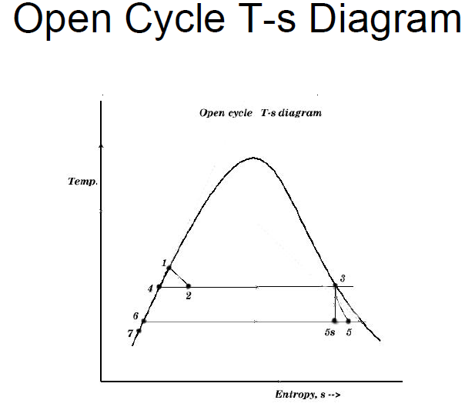

Slide 13
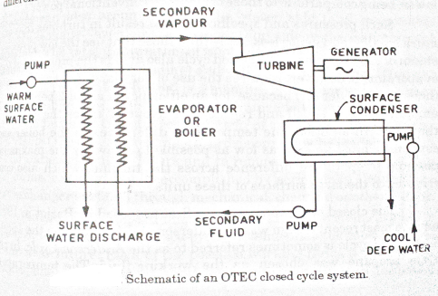
Closed cycle (Anderson) OTEC system

Slide 14
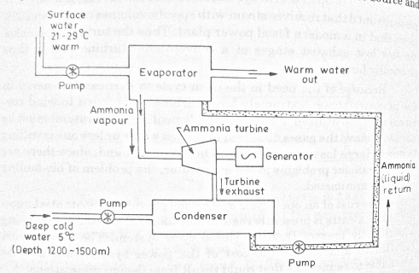
Closed OTEC Ammonia cycle

Slide 15
Closed-cycle systems use fluids with a low boiling point, such as ammonia, to rotate a turbine to generate electricity.
Warm surface seawater is pumped through a heat exchanger, where the low-boiling-point fluid is vaporized.
The expanding vapor turns the turbo-generator.
Cold deep seawater—which is pumped through a second heat exchanger—then condenses the vapor back into a liquid that is then recycled through the system.

